Slide 1
Online Art Gallery
Presented By :-
Kariya Kartik 201506100110065
Jariwala Karan 201506100110070
Group Number :-
32
Project Guide :-
Mr. Sapan Naik

Slide 2
Contents
Project Definition
Project Objective
Project Scope
Identification Of Need
Technology Used
Functional & Non-Functional Requirements
Modules
User Characteristics
Use Case Diagram
Activity Diagram
Data Dictionary
User Interfaces

Slide 3
Project Definition
Online Art Gallery is an efficient web application which gives various opportunities to the artists for publishing their artwork.
System allows artists to upload their artwork in shop.
Customers can purchase from the shop.

Slide 4
Project Objective
Objective of this system is to provide, both the customers and the artists to ease their work of buying and selling of arts.
All artist’s can promote themselves for their work.
Through this system it provides income for new artists as well as for the professionals by keeping their art for auction and for shop.

Slide 5
Project Scope
Online art gallery system is only for the art personals as well as for those customers who are passionate about arts.
Currently this system is limited for India.
This system does not follow the traditional art categories, instead we bifurcate different types of art based on modern era.
The system is feasible for visual arts.

Slide 6
Identification Of Need
Primary need of this system is to sale the artwork online.
To meet the needs of the artists who could not find the customers easily for their work.
To save the efforts of customers.

Slide 7
Technology Used
Back End :-
PHP
Apache
Front End :-
HTML
CSS
Tools :-
NetBeans
UmLet
Database :-
MySql

Slide 8
Functional Requirements
Manage Artist :-
Admin can add, remove, update and view artist details.
Artist can also handle their own profile.
Manage Customer :-
Admin can add, remove, update and view customer.
Artist can also manage their customers.
Customer can also handle their own profile.
Manage Shop :-
Artist can upload their arts in the shop for selling and also manage the shop details.
Order Booking :-
Customer can order the arts from the shop.

Slide 9
Functional Requirements
Payment :-
Online payment through PayUMoney.
Searching :-
Admin, customer and artist can search any Artwork and Artist.

Slide 10
Non-Functional Requirements
Download Disable :-
Customer, artist and admin can not download any art file.
Encryption :-
All the private details will be stored after applying MD5 encryption algorithm.
Mail :-
Mail for successful registration and for successful purchase.
SMS :-
SMS for Payment Successfully Done.

Slide 11
Non-Functional Requirements
Ratings:-
Customers can give their ratings to different arts and artists.

Slide 12
Modules
Registration
Admin
Manage Artists
Manage Customers
Manage Artist Profile
Gallery
Manage Customer Profile
Shop

Slide 13
User Characteristics
Admin | Artist | Customer
Log In | Registration and Log In | Registration and Log In
Manage artists and customers | Manage own profile and view others profile | Manage own profile and view Artists profile
Manage gallery | View gallery | View gallery
View Shop | Manage own shop details | View shop and Order booking
View ratings | View ratings | Add,update and view ratings

Slide 14
Use Case Diagram
Admin
Artist
Customer

Slide 15
Activity Diagram
Log In
Registration
Manage Artist
Manage Customer
Manage Shop
Manage Gallery
Order Booking

Slide 16
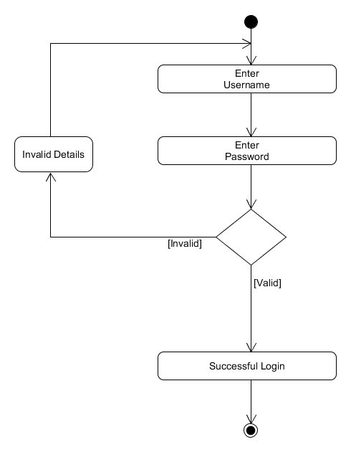
Log In

Slide 17
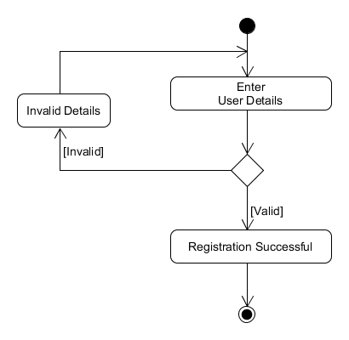
Registration

Slide 18
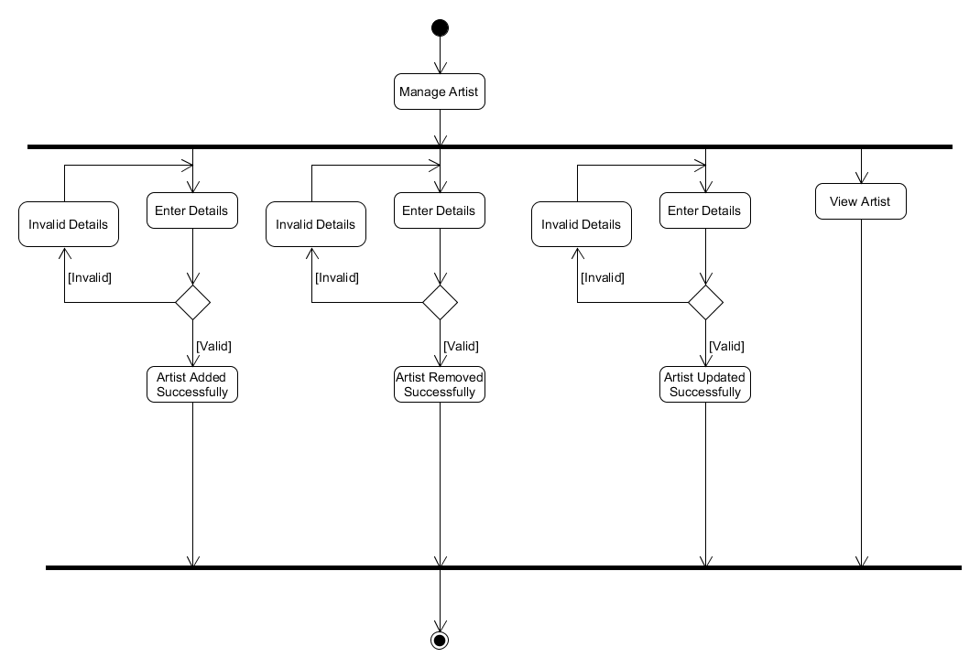
Manage
Artist

Slide 19
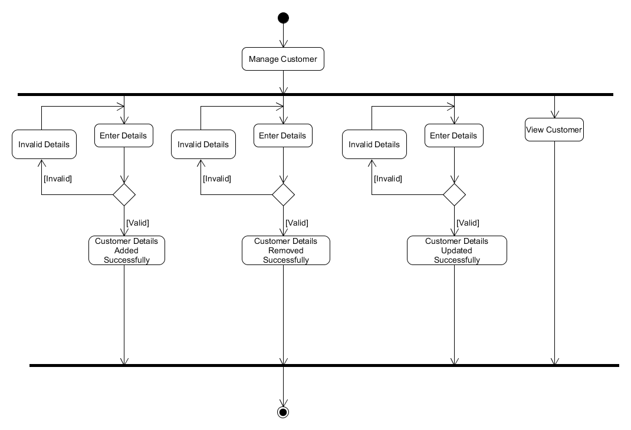
Manage
Customer

Slide 20
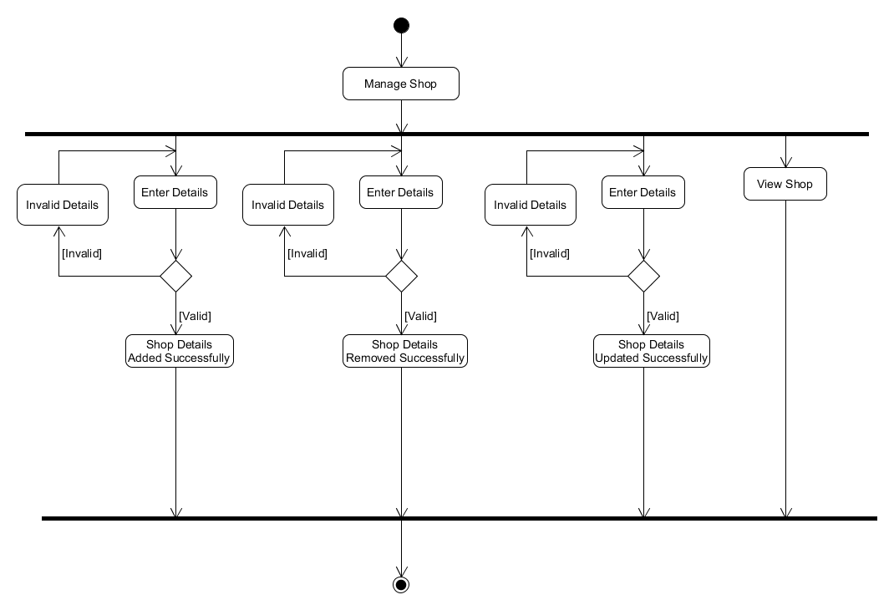
Manage
Shop

Slide 21
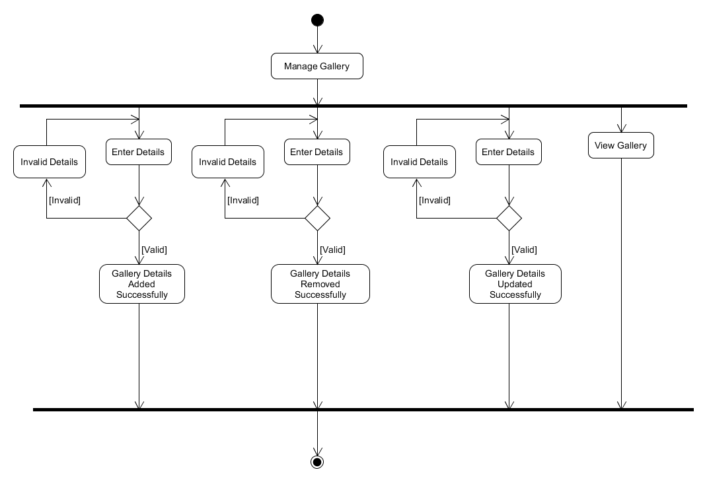
Manage
Gallery

Slide 22
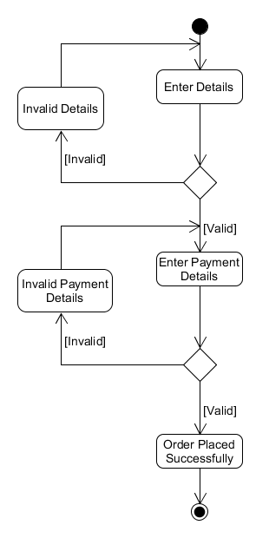
Order
Booking

Slide 23
Data Dictionary
Artist
Customer
Country
State
City
Category
Subject
Shop
Cart
Shop_Order
ArtGallery
ArtRating
ArtistRating

Slide 24
Artist
Field Name | Datatype | Size | Constrain | Description
Artist_Id | Integer | - | Primary Key | Unique Id
firstname | Varchar | 15 | Not null | First name of the artist
lastname | Varchar | 15 | Not null | Last name of the artist
username | Varchar | 30 | Not null | Username of the artist for login
password | Varchar | Max | Not null | Password of the artist for login

Slide 25
Cont...
Field Name | Datatype | Size | Constrain | Description
email_Id | Varchar | 30 | Not null | Email id of the artist
contact_number | Varchar | 13 | Not null | Artist contact number
date_of_birth | Date | - | Not null | Artist birth date
city_id | Integer | - | Foreign Key | City id as reference
qrimg | Varchar | Max | Not null | Path of an qr image

Slide 26
Cont...
Field Name | Datatype | Size | Constrain | Description
qrcode | Varchar | 30 | Not null | Value of qrcode
profile_image | Varchar | Max | Not null | Path of profile image
idproof_image | Varchar | Max | Not null | Path of Id proof image
legal_name | Varchar | 30 | Not null | Legal name of an artist as per government id proof

Slide 27
Cont...
Field Name | Datatype | Size | Constrain | Description
street _address | Varchar | Max | Null | Street address of an artist
state_id | Integer | - | Foreign key | State id as reference
country_id | Integer | - | Foreign key | Country id as reference
zipcode | Integer | - | Not null | Zipcode of artist residence
about_me | Varchar | Max | Null | Description about the artist

Slide 28
Cont...
Field Name | Datatype | Size | Constrain | Description
education | Varchar | Max | Null | Education details of an artist
artist_googleplus | Varchar | Max | Null | Link of google+ account of an artist
artist_twitter | Varchar | Max | Null | Link of twitter account of an artist
artist_facebook | Varchar | Max | Null | Link of facebook account of an artist

Slide 29
Cont...
Field Name | Datatype | Size | Constrain | Description
artist_instagram | Varchar | Max | Null | Link of instagram account of an artist
artist_website | Varchar | Max | Null | Personal website link of an artist
status | Varchar | 8 | Not null | Active / Deactive status of an artist account
verification | Varchar | 8 | Not null | Pending / Approved verification of an artist account

Slide 30
Customer
Field Name | Datatype | Size | Constrain | Description
Customer_Id | Integer | - | Primary key | Unique Id
Firstname | Varchar | 20 | Not null | Firstname of customer
Lastname | Varchar | 20 | Not null | Lastname of customer
Username | Varchar | 30 | Not null | Username of the customer for login
Password | Varchar | Max | Not null | Password of customer for login

Slide 31
Cont...
Field Name | Datatype | Size | Constrain | Description
Email_Id | Varchar | 30 | Not null | Email id of customer
Contact_Number | Varchar | 13 | Not null | Contact number of customer
Profile_Image | Varchar | Max | Not null | Path of profile image of customer
status | Varchar | 8 | Not null | Active / Deactive status of an customer account

Slide 32
Country
Field Name | Datatype | Size | Constrain | Description
Country_Id | Integer | - | Primary key | Unique id
Country_Name | Varchar | 15 | Not null | Name of the Country

Slide 33
State
Field Name | Datatype | Size | Constrain | Description
State_Id | Integer | - | Primary key | Unique id
State_Name | Varchar | 15 | Not null | Name of the State
Country_Id | Integer | - | Foreign key | Country id as a reference

Slide 34
City
Field Name | Datatype | Size | Constrain | Description
City_Id | Integer | - | Primary key | Unique id
City_Name | Varchar | 15 | Not null | Name of the city
State_Id | Integer | - | Foreign key | State id as a reference

Slide 35
Category
Field Name | Datatype | Size | Constrain | Description
Category_Id | Integer | - | Primary key | Unique id
Category_Name | Varchar | 15 | Not null | Category of art
Status | Varchar | 8 | Not null | Activate or Deactivate Category

Slide 36
Subject
Field Name | Datatype | Size | Constrain | Description
Subject_Id | Integer | - | Primary key | Unique id
Subject_Name | Varchar | 15 | Not null | Subject of art
Status | Varchar | 8 | Not null | Activate or Deactivate Subject

Slide 37
Shop
Field Name | Datatype | Size | Constrain | Description
Shop_Id | Integer | - | Primary key | Unique id
Artist_Id | Integer | - | Foriegn key | Artist id as a reference
Art_Title | Varchar | 20 | Not null | Title Of an Artwork
Art_File | Varchar | Max | Not null | Path of Image file of an Artwork
Art_Category | Varchar | 12 | Not null | Category of an Artwork

Slide 38
Cont...
Field Name | Datatype | Size | Constrain | Description
Art_Subject | Varchar | 12 | Not null | Subject of an Artwork
Year | Integer | - | Not null | Year of creation of an Artwork
Art_Mediums | Varchar | Max | Not null | Mediums of an Artwork
Art_Materials | Varchar | Max | Not null | Materials of an Artwork
Art_Styles | Varchar | Max | Not null | Styles of an Artwork

Slide 39
Cont...
Field Name | Datatype | Size | Constrain | Description
Art_Keyword | Varchar | Max | Not null | Keywords of an Artwork
Height | Float | - | Not null | Height of an Artwork
Width | Float | - | Not null | Width of an Artwork
Description | Varchar | Max | Not null | Description of an Artwork
Zipcode | Integer | - | Not null | Zipcode from where Artwork will Dispatch

Slide 40
Cont...
Field Name | Datatype | Size | Constrain | Description
Price | Double | - | Not null | Price of an Artwork
Shipping_Cost | Double | - | Not null | Shipping cost of an Artwork
Total_Amount | Double | - | Not null | Total amount of an Artwork
Date | Varchar | 10 | Not null | Uploading date of an Artwork

Slide 41
Cont...
Field Name | Datatype | Size | Constrain | Description
Street_Address | Varchar | Max | Not null | Street address from where Artwork will Dispatch
City_Id | Integer | - | Not null | City id as a reference
State_Id | Integer | - | Not null | State id as a reference
Country_Id | Integer | - | Not null | Country id as a reference

Slide 42
Cont...
Field Name | Datatype | Size | Constrain | Description
Price | Double | - | Not null | Price of an Artwork
Ship_Cost | Double | - | Not null | Shipping cost of an Artwork
Date | Varchar | 10 | Not null | Uploading Date of an Artwork
Time | Varchar | 8 | Not null | Uploading Time of an Artwork

Slide 43
Cart
Field Name | Datatype | Size | Constrain | Description
Cart_Id | Integer | - | Primary key | Unique id
Shop_Id | Integer | - | Foreign key | Shop id as a reference
Customer_Id | Integer | - | Foreign key | Customer id as a reference
Quantity | Interger | - | Not null | Purchase quantity Of an Artwork

Slide 44
Cont…
Field Name | Datatype | Size | Constrain | Description
Total_Price | Double | - | Not null | Total price of an Artwork
Cart_Status | Integer | - | Not null | Cart Status for available or not in cart

Slide 45
Shop_Order
Field Name | Datatype | Size | Constrain | Description
ShopOrder_Id | Integer | - | Primary key | Unique id
Cart_Id | Integer | - | Foreign key | Cart id as a reference
Email_Id | Varchar | Max | Not null | Email id of an Customer
Contact_Number | Varchar | 13 | Not null | Contact number of Customer
Street_Address | Varchar | Max | Not null | Street address at where Artwork will be Deliver

Slide 46
Cont…
Field Name | Datatype | Size | Constrain | Description
City_Id | Integer | - | Not null | City Id as a reference
State_Id | Integer | - | Not null | State Id as a reference
Country_Id | Integer | - | Not null | Country Id as a reference
Zipcode | Integer | - | Not null | Zipcode of entered by customer
Status | Varchar | 12 | Not null | Tracking status of an Artwork

Slide 47
Cont…
Field Name | Datatype | Size | Constrain | Description
Amount | Double | - | Not null | Total amount will be paid by customer
Date | Varchar | 10 | Not null | Purchasing Date of an Artwork
Time | Varchar | 8 | Not null | Purchasing Time of an Artwork

Slide 48
ArtGallery
Field Name | Datatype | Size | Constrain | Description
ArtGallery_Id | Integer | - | Primary key | Unique id
File | Varchar | Max | Not null | Path of an gallery image
Status | Varchar | 10 | Not null | Activate or Deactivate Gallery

Slide 49
ArtRating
Field Name | Datatype | Size | Constrain | Description
ArtRating_Id | Integer | - | Primary key | Unique id
Shop_Id | Integer | - | Foreign key | Shop id as a reference
Customer_ Username | Integer | - | Not null | Customer username as a reference
Ratings | Integer | - | Not null | Ratings by the customer

Slide 50
ArtistRating
Field Name | Datatype | Size | Constrain | Description
ArtistRating_Id | Integer | - | Primary key | Unique id
Artist_Id | Integer | - | Foreign key | Artist id as a reference
Customer_ Username | Integer | - | Not null | Customer username as a reference
Ratings | Integer | - | Not null | Ratings by the customer

Slide 51
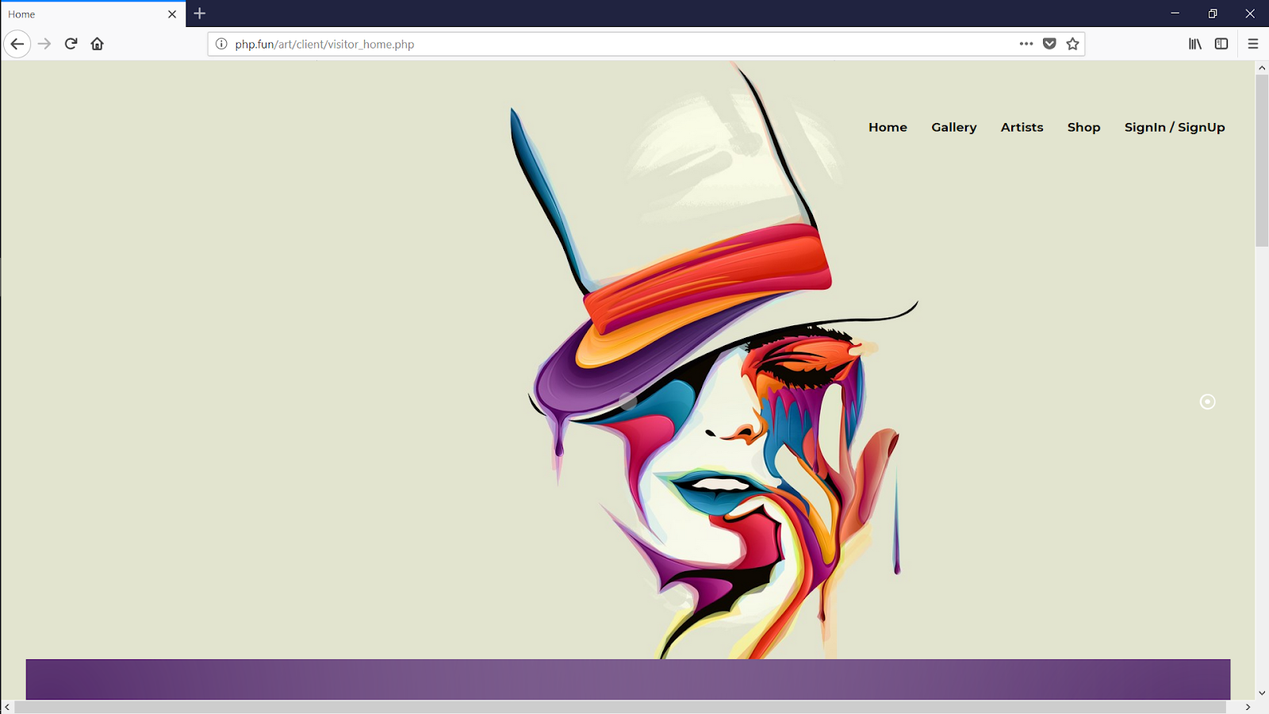
User Interfaces

Slide 52
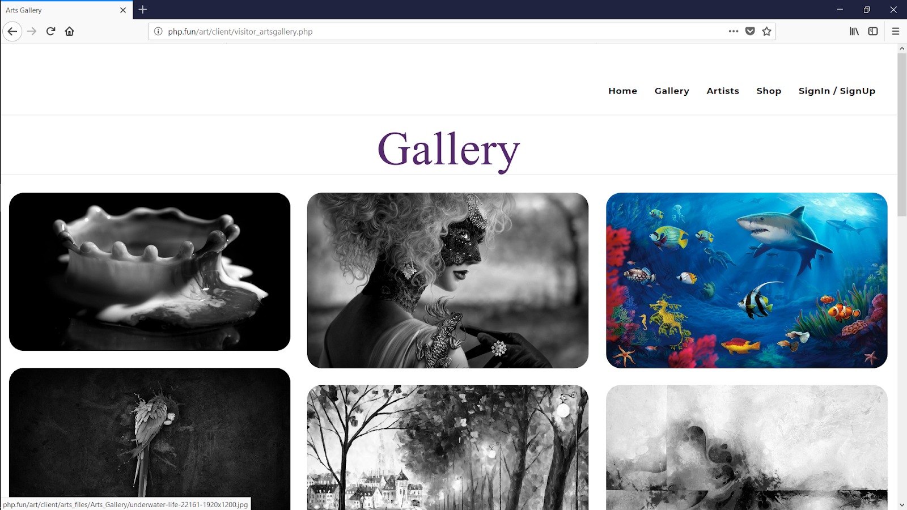

Slide 53
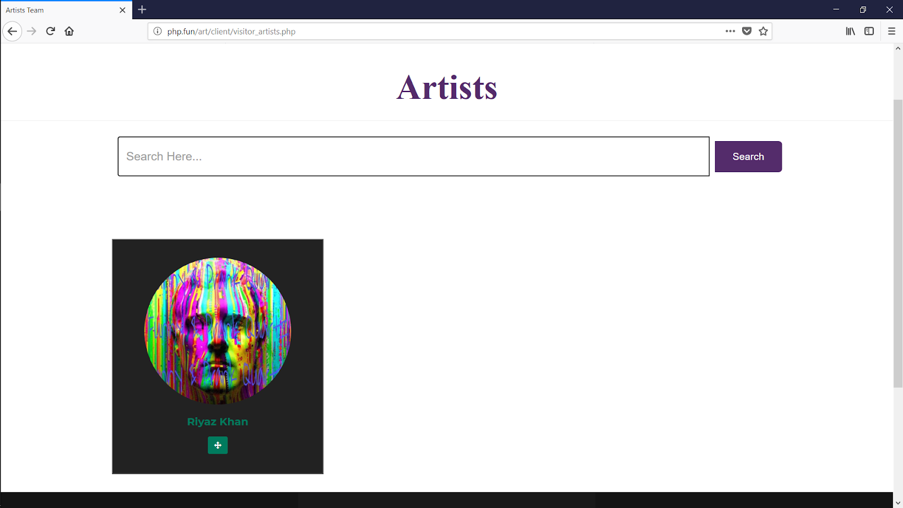

Slide 54
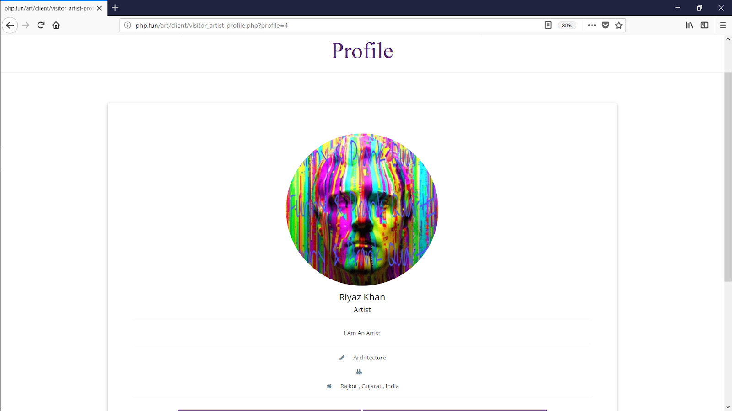

Slide 55
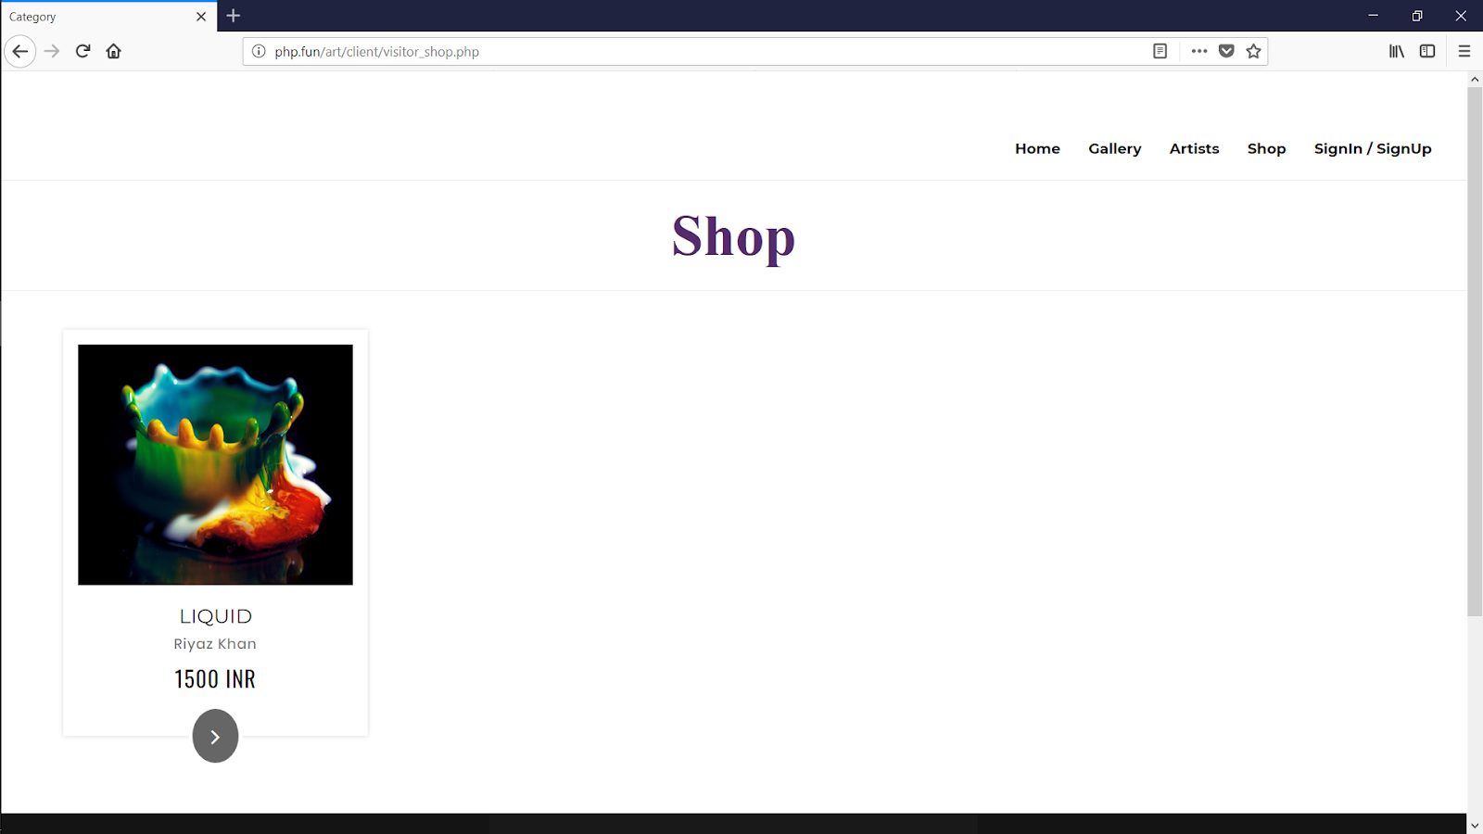

Slide 56
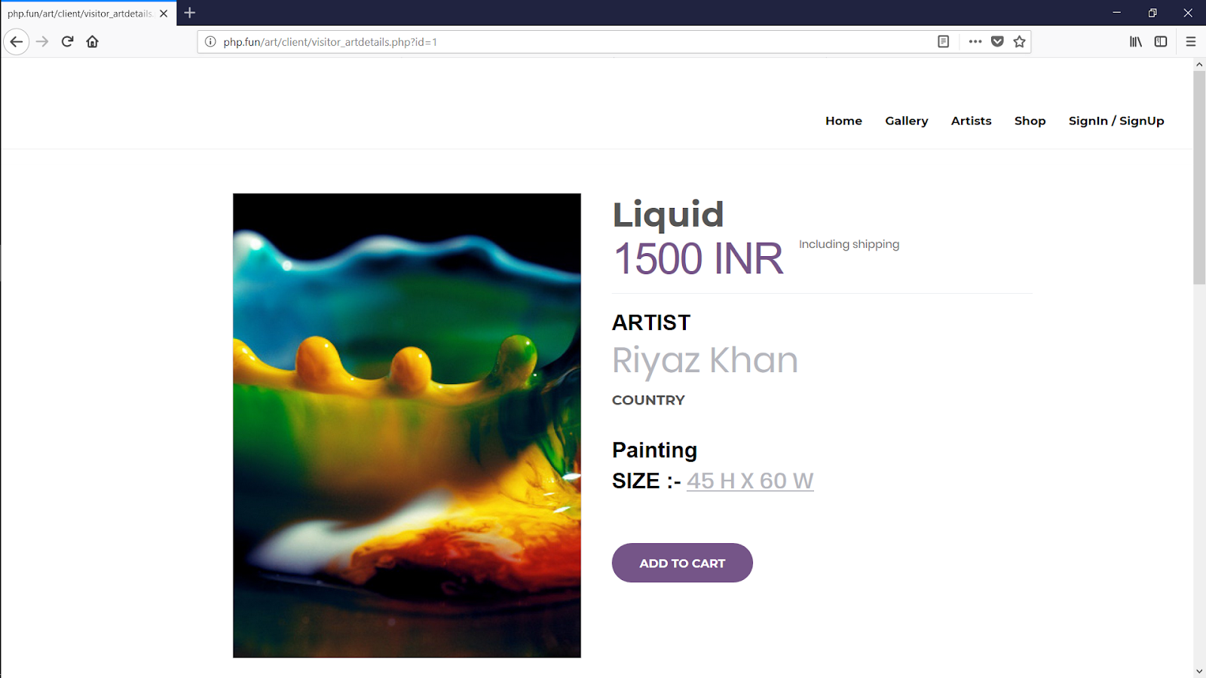

Slide 57
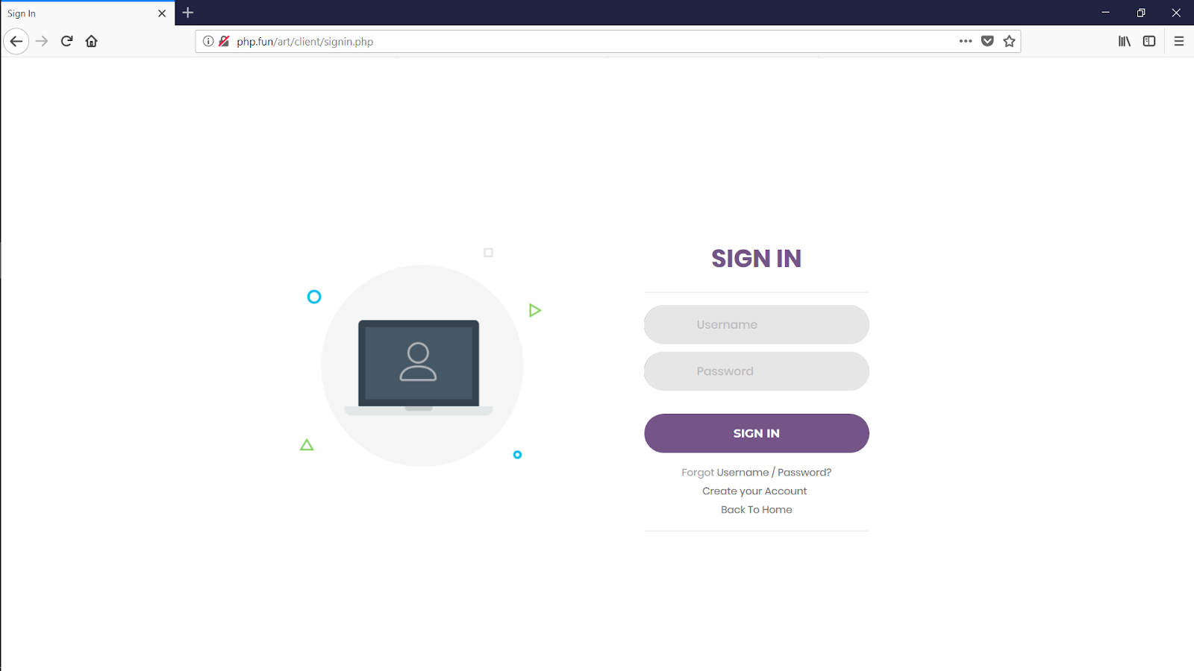

Slide 58


Slide 59
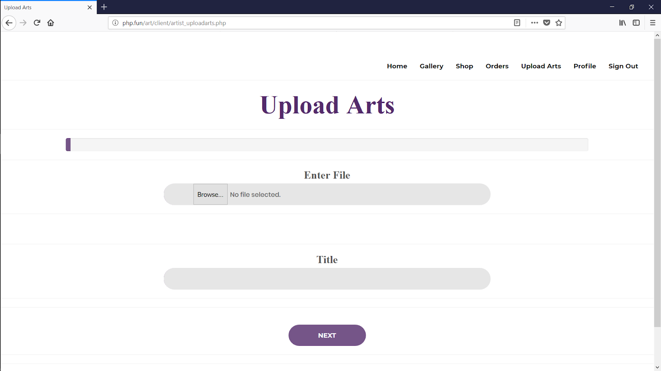

Slide 60
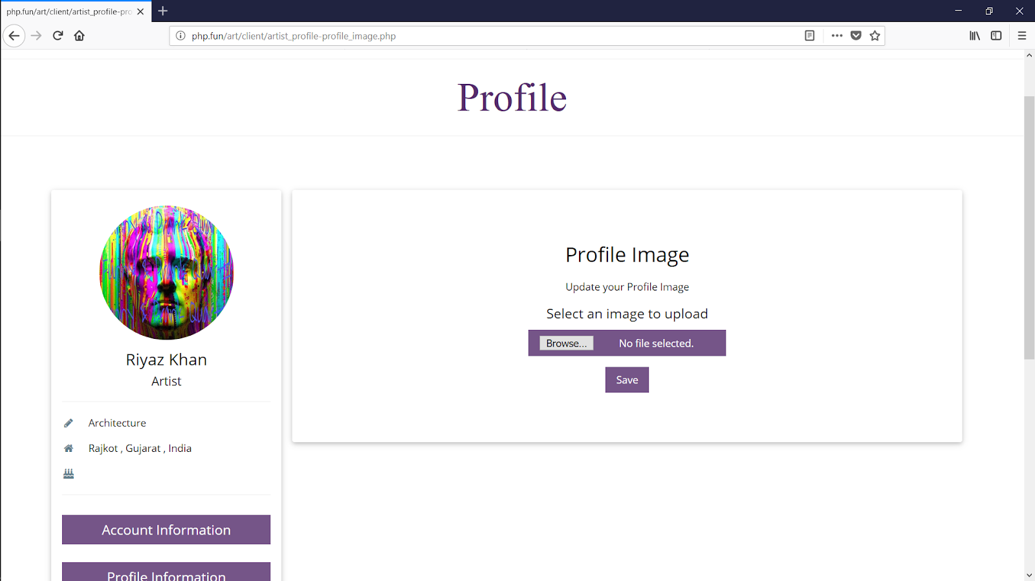

Slide 61
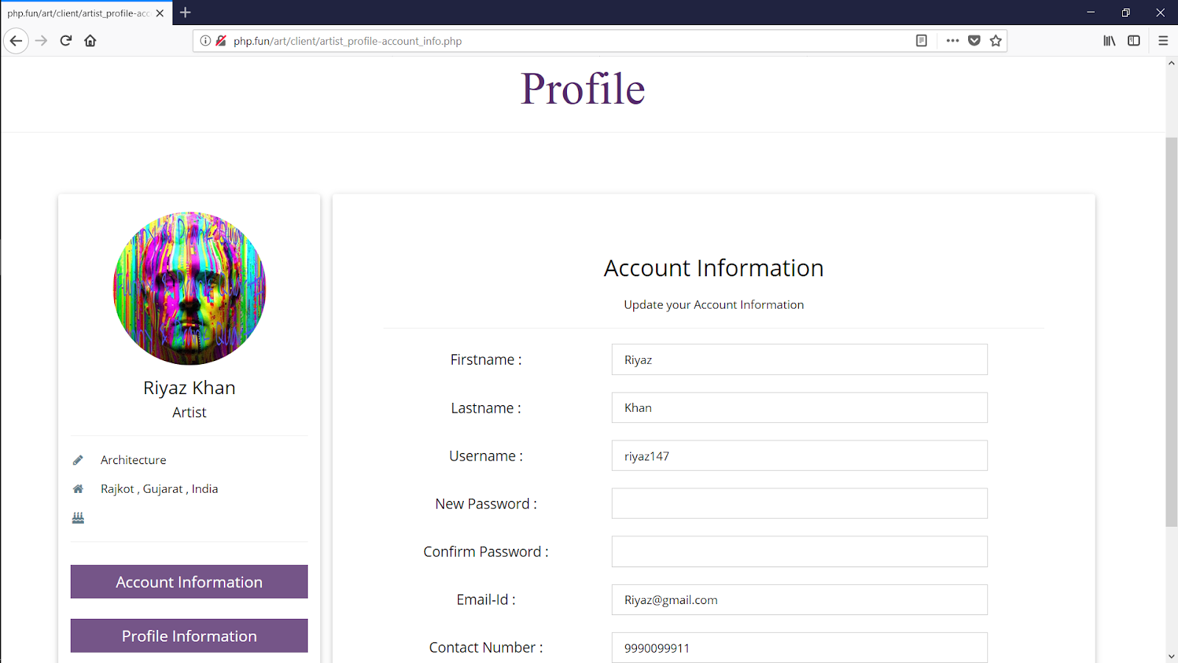

Slide 62
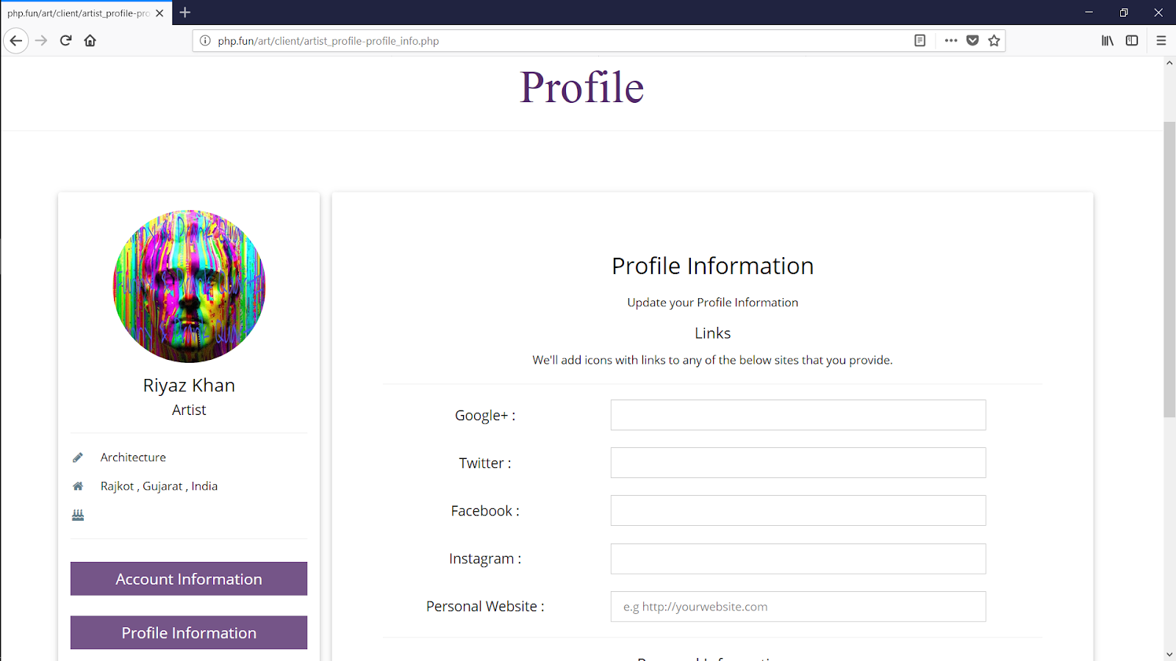

Slide 63
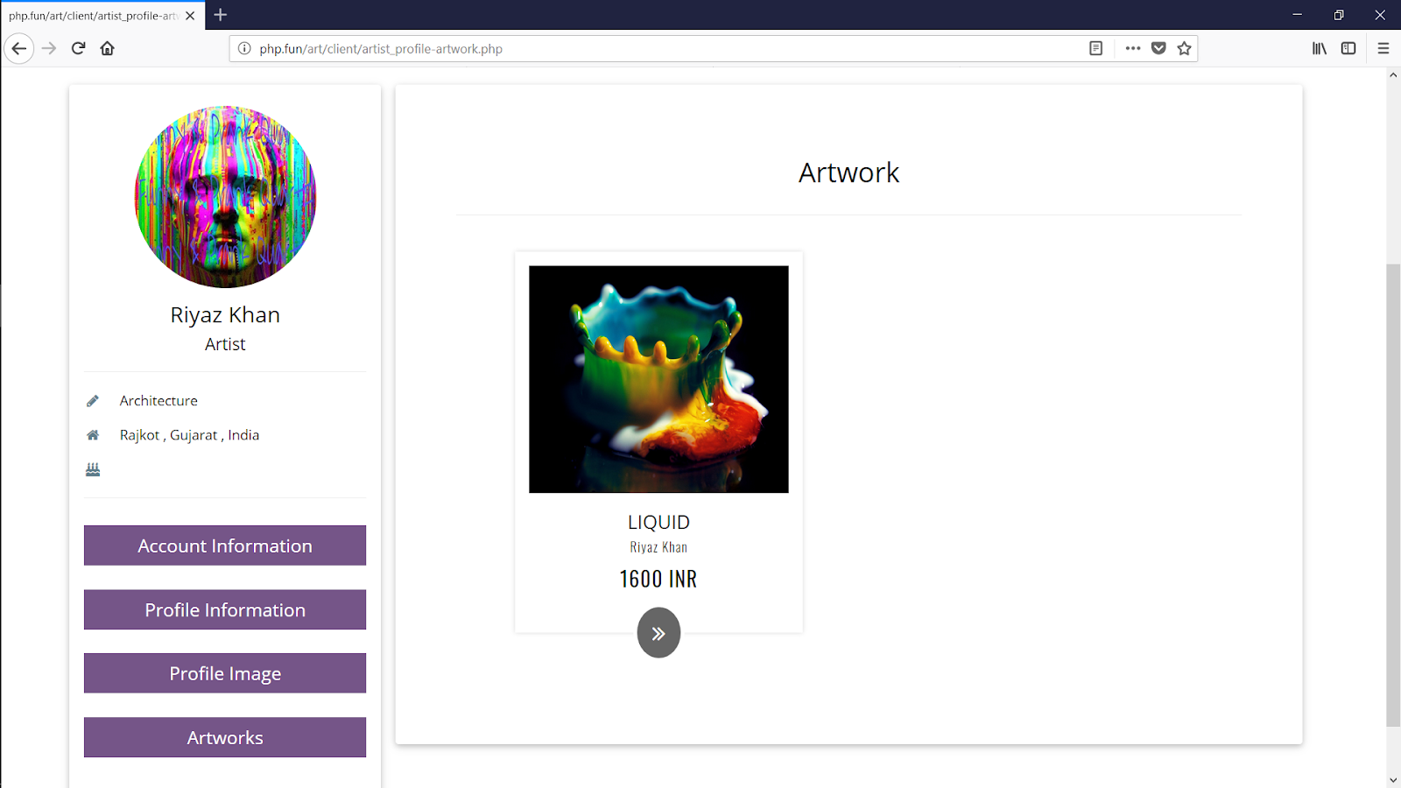

Slide 64


Slide 65
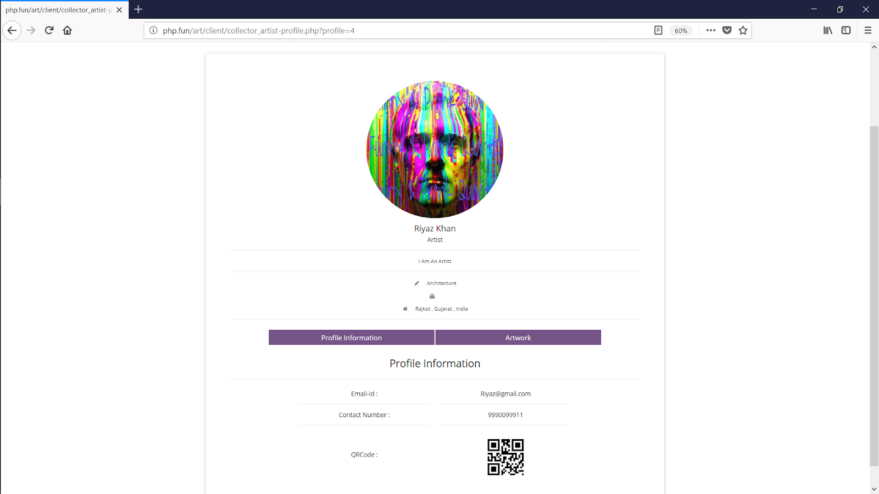

Slide 66
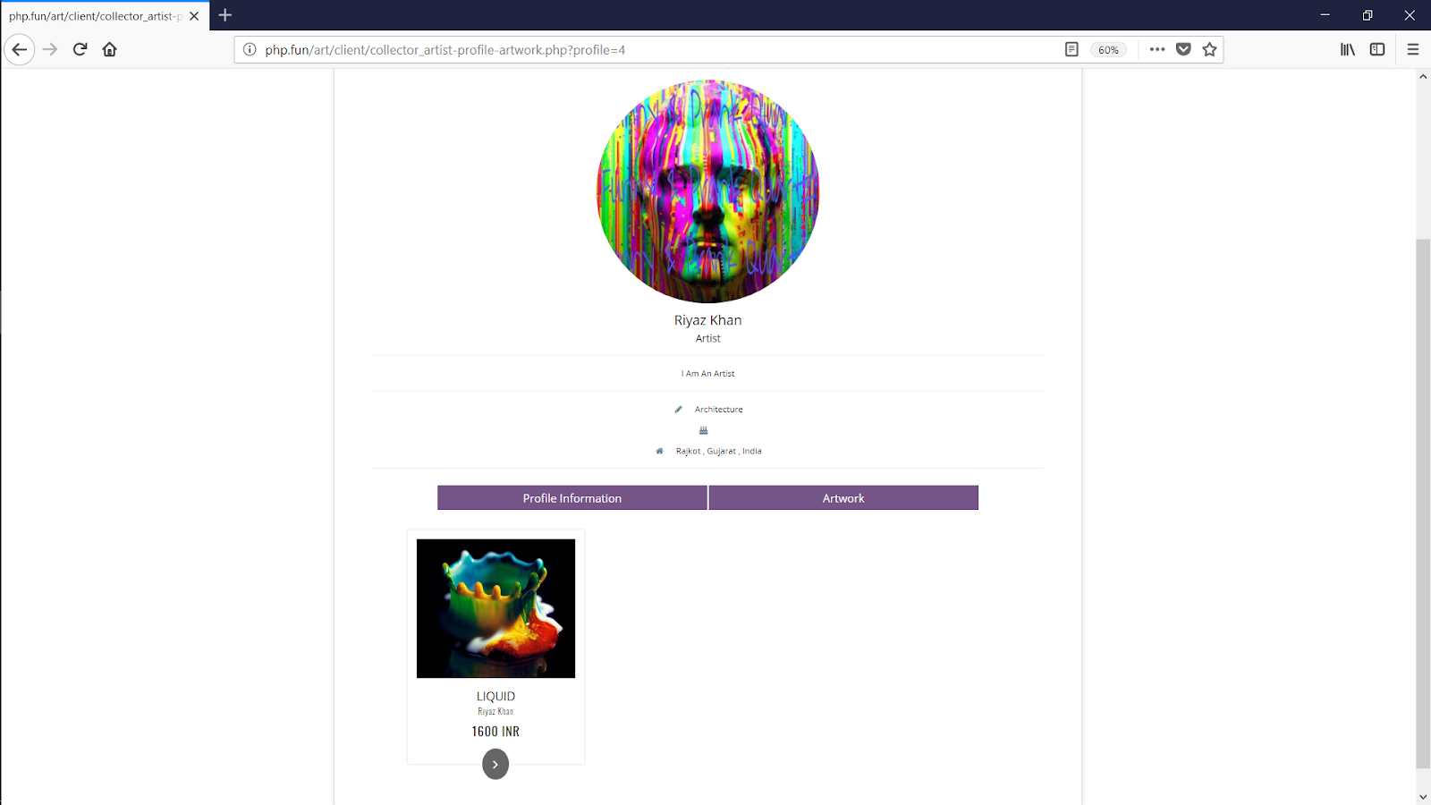

Slide 67
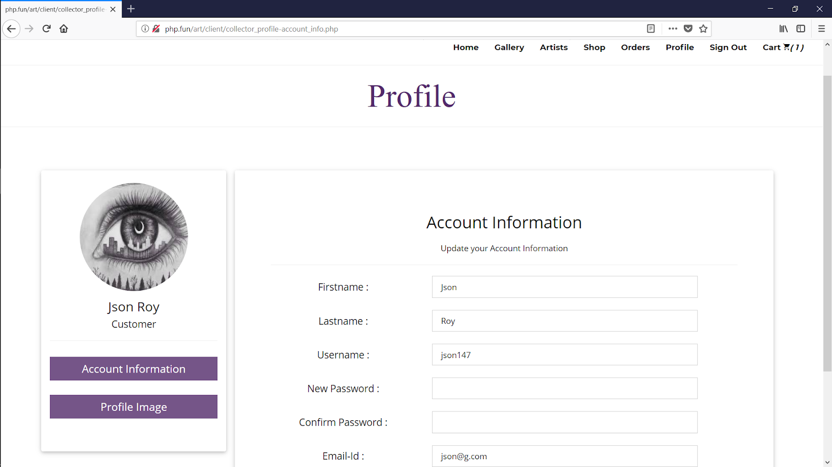

Slide 68
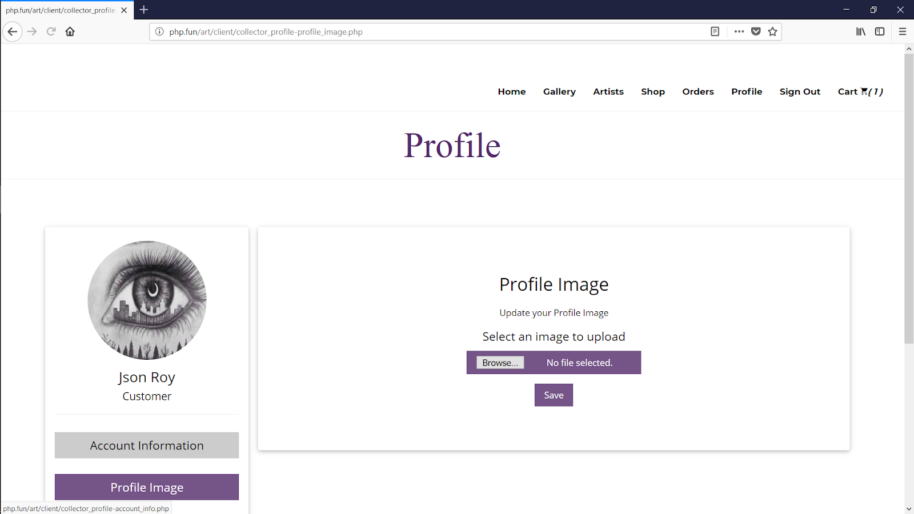

Slide 69
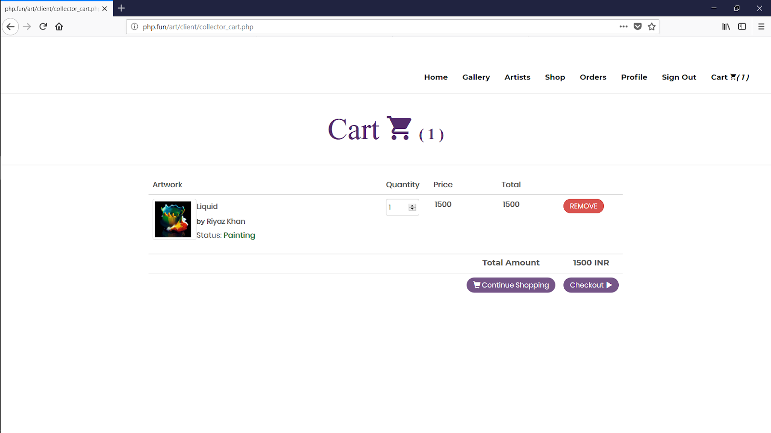

Slide 70
